Slide 1
What Works Series: Focused Deterrence 29th November 2024 Tori Olphin, M.B.E. – Head of Data Science, Research and Evaluation, Thames Valley Violence Prevention Partnership Sarah Bottomley - Independent Chair and Strategic Lead for Missing and Exploitation, Milton Keynes City Council

Slide 2
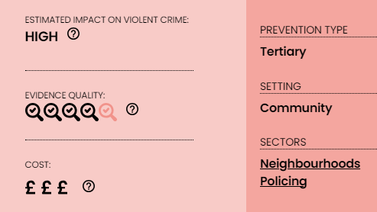
Focused Deterrence in Thames Valley
Identified as having potential for high impact by YEF
How did we conduct the trial?
What did we find?
What did our partners think?

Slide 3
Shared, Common and Costly Problem
Carrying and use of knives by children and young people in Milton Keynes affects all public services​
All agencies incur costs and manage risk in this space
Focused deterrence was decided upon as a shared project to target habitual knife offenders
So the idea was put through the research project lifecycle to work out the best way to implement…

Slide 4
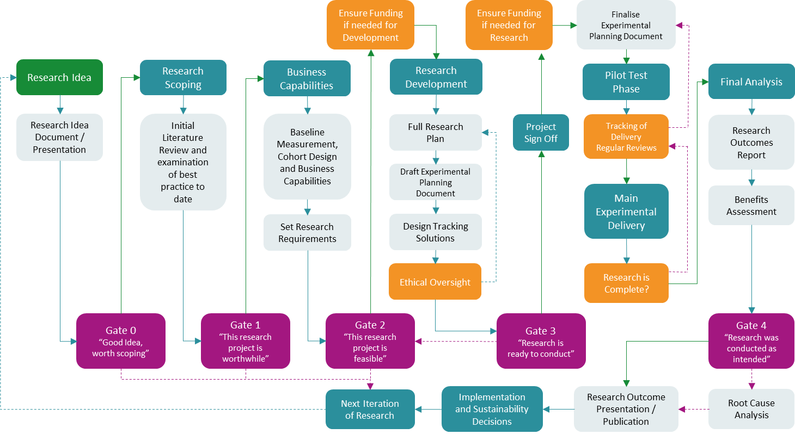
Research Project Lifecycle
Reference: Adapted from Olphin, T.P.A. (2023). Research Project Lifecycle: A Structured Approach to Conducting Research in the Public Sector. Reading, UK: Thames Valley Violence Reduction Unit. @ Crown Copyright 2023

Slide 5
Review of Previous Literature
Evidence shows promise
Evidence almost entirely from US cities
Works well in high violence cohorts, and in violent groups
No strong evidence from UK or similar countries
Need to test efficacy in UK setting

Slide 6
What is the Focused Deterrence Trial?
Randomised Controlled Trial
First full trial to go through the research project lifecycle (See appendix)
Took under a month to go from idea to fully designed experiment
Strong existing understanding of evidence base within our team
Very clear following Gate 0 that all agencies’ had a consistent problem that suited focused deterrence
Young people (under 25) involved in repeat knife offending, or knife and violent or sexual offending
Does offering them social care led problem solving, to provide immediate support in ways that suit them, alongside a procedurally just policing deterrence approach, reduce reoffending in the treatment cohort?​

Slide 7
Cohort Identification
Small budget available, so impact needed to be maximised by selecting cohort with likely offending
Good data science is essential for selecting productive cohorts
Needed to be a cohort that both police and social services could agree was appropriate for the intervention
Avoiding expert selection
Hard to ensure cohort will have high levels of reoffending
Findings would be much easier to replicate or implement if based on data identified rules
Young people (11-25) who have had at least one knife offence as a suspect in the past 12 months and one of another knife offence, a violent offence, or a sexual offence as a suspect in the past 24 months
Either repeat knife offenders, or knife offenders who have also shown propensity to conduct violent or sexual offences

Slide 8
What is Focused Deterrence in Milton Keynes?
Social care led problem solving approach from a dedicated case worker
Procedurally-just police response to cases that fail to engage, or who continue to offend
In depth and intensive problem solving approach that lasts 12 months for each member of the cohort
The young person gets a visit from social care explaining the process and what will happen (that they will receive tailored support from a dedicated care worker, but that the police will intervene rapidly if there is any sign of continued offending)
Police officer visits to explain from the police side after this, to demonstrate involvement and attention, but also to show that they won’t be involved if the offending stops and the engagement with social care prevents their involvement in crime

Slide 9
What was delivered?
Eligible cases identified
Multi-agency care-led approach
Working out how to help, not taking the easy option
Person centred problem solving
Trusted adult, allocated long term, who they could build a supportive relationship with
The suite of options grew as the trial progressed
In depth problem solving, done with the young person, not to them
Tracking at all stages
Randomised
Multiagency Panel
Business as Usual
Allocated to Case Worker
Case Worker Visit
Police Visit
In depth problem solving, with procedurally just policing

Slide 10
How is it delivered?
Funded by Thames Valley Violence Prevention Partnership as part of Home Office Violence Reduction Unit Programme
Very small scale randomised trial
£150,000 per year (match funded by police officer time and social services supervision and management)
Design of intervention, research design, and evaluation conducted in house
Milton Keynes Contextual Safeguarding Team
Two case workers and one analyst, plus their management time
Milton Keynes LPA Problem Solving Team
Dedicated PC plus case management by supervision and problem solving Inspector
Case workers can manage 20-25 knife offenders each, at a delivery cost of £2,000 to £2,500 per case of additional resource

Slide 11
What is Procedural Justice?
Procedurally-just policing relates to delivery of policing that would be seen by the person being policed as being fair
including dialogue that encourages participation in the proceedings prior to decisions being made
response being proportionate to what has been done
this being understood so that the motives of the police are seen to be trustworthy
the authority demonstrating dignity and respect throughout the interaction
How this was incorporated
Meeting the young person and explaining the program
Explaining the fact that enforcement would be done if they keep on offending
Allowing questions to be asked
Demonstrating support – we are trying to help not prosecute
All cases were discussed between teams to ensure proportionate and fair response could be delivered if criminal behaviour did occur

Slide 12
What was delivered?
Support Types for 11-17 Year Old Cohort
Support to access education / employment
Allocation of a Social Worker
CAMHS Referral
SALT (Speech and Language) Assessment
YJS Worker
Allocation of a Youth Worker
1:1 Knife Crime Work
Referral to a Sports Worker
Additional financial support to access positive activities
NRM Referral
Young Person Mapping
Criminal Exploitation Worker – Young Person
Drug and Alcohol Service
Mentor
SAIT (Specialist Assessment and Intervention Team
AIG (Advice, Information and Guidance)
Support Types for 18-25 Year Old Cohort
1:1 Knife Crime Work
Referral to CAMHS / Adult Mental Health Support
Support to access education / employment
Support to access Probation
Allocation of a Social Worker
Mentor
Support to access GP / Health Appointment
Allocation of a Youth Worker
SALT (Speech and Language) Assessment
Support around Budgeting
Housing Support
Safety planning with parents / carers
Young Person Mapping
Drug and Alcohol Service

Slide 13
Relationships and People
Initially there was not agreement on how the programme should work
Finding common ground, and something to agree on
Admitting no evidence, and that it would be beneficial to test
Small planning team
Head of Contextual Safeguarding (Sarah)
Problem Solving Inspector (Amy)
Head of Research (Tori)
Recruiting people who really cared
Strong analyst who tracked the programme (Marcus)
Two case workers who really cared, and who problem solved and added to the options for helping the young people (Molly and Mandy)

Slide 14
Some Key Learning
Due to the type of offender being worked with, it was not expected that many would engage
But most (17 out of 20) have engaged in the 11-17 cohort
18-24 cohort has been more difficult to reach, with only 10 out of 25 engaging
The non-engagements include 2 Individuals in long term custody, 1 individual with complex mental health where it was decided that the project would not be in his best interest, 1 Individual who is currently wanted by Police, and 7 individuals who are unable to be located by the coordinator or police.
True problem solving approach
MK social care had an original suite of options and have expanded this due to the needs of members of the cohort
We thought that most would also be under statutory provision with MK council
This has not been found to be the case, with allocation of a social worker being required in most cases (17/20 under 18s)

Slide 15
Results of the Trial after 12 months
A glossy ‘What Works’ report has been circulated, but please request it to be sent to you if you have not received it already. To reference, please use:
Olphin, T., Bottomley, S., Webb, A. & Stock, M. (2024) What Works Series: Focused Deterrence 12 Month Findings, Thames Valley Violence Prevention Partnership: Kidlington, UK

Slide 16
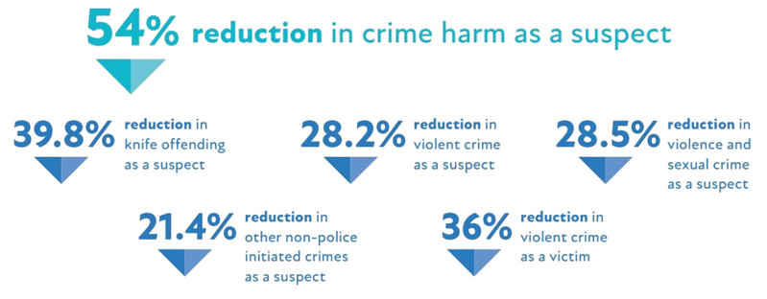
Overall experimental findings – all age groups
Statistically significant – less than 5% likelihood the finding was due to chance
Not statistically significant – more than 5% likelihood the finding was due to chance, but collectively they show positive results

Slide 17
Engagement in Focused Deterrence
Delivery was much more difficult in over 18s
Sub-group analysis only conducted for under 18s due to level of engagement

Slide 18
Immediate Impact on Offending
Statistically significant – less than 5% likelihood the finding was due to chance

Slide 19
Statistical significance and confidence
Statistical significance simply shows that mathematically there is less than 5% likelihood that the finding was by chance
However, it is not the only important thing:
All of the findings going in the same direction also provide confidence in the combined findings
There are no identified backfire effects and so, if seen as cost-effective, statistical significance may not be the most important thing

Slide 20
What does this mean?
Social care-led person-centred problem solving, conducted in a long term in-depth manner where a trusting relationship is built with the case worker, supported by a procedurally-just policing response, appears to reduce offending and victimisation in the most serious crime types by a large and significant amount

Slide 21
What does this mean?
Massive reduction in serious violence and knife related crime
Use of a randomised controlled trial allows us to conclude that this is due to the intervention

Slide 22
What does this mean?
Potential for reductions in knife offending are massive
Cohorts need to be well-identified or this will become expensive to run
Engagement
under 18s higher than expected
Freedom to act on almost any area was important
Consistency in case worker, and long term commitment allowed for detailed problem solving
Harder to engage older group

Slide 23
Implications for wider adoption and next steps
Potential for massive population level benefits
Small trial, so ideal implementation would involve either replication of test, or experimental implementation to test similar delivery
Results should be generalizable if delivering a very similar intervention, in a very similar cohort who have a similar level of offending
Good data science for cohort identification is essential for effective resource allocation, and this should be tested in other areas to test validity of this cohort selection criteria

Slide 24
Implications for wider adoption and next steps
If implementing a version of this, the findings relate to (and are generalizable to):
a person-centred problem solving approach
based in children’s social care
supported by a procedurally-just police response if there is continued offending
It is the view of these authors that it would be less effective if implemented within policing, or within a voluntary or community sector partner as they would have less easy access to data and additional services
Case workers need to remain able to conduct in-depth problem solving. Based on our pilot testing, it is recommended that a maximum caseload of 20-25 per case worker should be used (though this could be tested further)

Slide 25
Observations on Dosage and Exiting
Such strong findings from this trial indicate that the level of dosage (one whole year of in-depth problem solving) is of benefit
Compared to other trials with lower dosage, these findings are more impactful, but more resource intensive
The level of dosage that would be most effective has not been tested
It would be possible, and useful, to run a trial where the same treatment is given, but for different dosages to examine the impact change

Slide 26
From Social Care: Running this as an RCT…
Professional nervousness around not using professional judgement
Nervousness around the ethics of not treating some but treating others
Work around
packaged as a bonus intervention to professionals
possibility of getting real evidence base for relationship based working that could then improve practice across the country
Some families and individuals not understanding why they were being offered this when their offence was over 6 months ago or the 2 offences were part of the same incident
packaged as a bonus offer for a personalised package of support/intervention
Evaluation process has been helpful – has demonstrated the value of flexible person centred approaches and giving time to build relationships to support engagement that could be replicated in other areas of practice including working with Care Leavers.​

Slide 27
From Social Care: Strengths
Flexibility in design and evolution
Working with the strengths of the locality to ensure it met local need
Ongoing analysis and monitoring so that programme could be tweaked as it went along
Continuous learning.
Setting in the local authority
Structure and relationships in place for information sharing and planning plus access to wide range of interventions
Children’s social care worked very well as a location to run this intervention

Slide 28
From Social Care: Strengths
Flexibility allowed with the individuals
not restricted by statutory timescales
know that person can be on the cohort for a year
low caseloads
provide space to build relationships
immediate support, adapt to their changing needs
work at their pace
Trauma informed “you don’t have to talk about knife crime straight away, you can talk around it until the person is ready”.
Can be intensive and taper off, or start slow and gather pace “sometimes people just need someone to hold them” (not like a cuddle)

Slide 29
From Social Care: Strengths
Personalised – good package of interventions from statutory and non-statutory partners
Something for everyone, meets all needs
Cohort saw things happen so encouraged engagement – trusted the workers and started to trust the police.
Panels
Space to reflect and adapt
No risk of drift or delay
Problem solving approach
Co-owned
Learning from practice

Slide 30
From Social Care: Challenges
Building momentum at the beginning especially due to the professional nervousness
Implementing a project in a space where there was so much else already happening
Keeping momentum with personnel changes in partnership, and also a police restructure programme changing geographic responsibilities
Adult cohort
More difficult to engage
Push/pull factors more entrenched
Difficult to locate and track down as more mobile

Slide 31
From Social Care: Ongoing benefits aside from positive outcomes
Relationships built on between partners so further strengthened
Example of how partners can all feel responsible for care/prevention plans for individuals and collaborate in the care (police didn’t just wait for the enforcement trigger, they actively engaged in the treatment)
Learning that can be adapted to other parts of the system including
Benefits of relationship based practice
Holistic offer
Low case loads to support immediacy of support
Flexibility to meet the needs of the individual
Better understanding of how to test and evaluate

Slide 32
From Social Care: Some Key Learning
The name made it more difficult to “sell” – doesn’t fit a child based perspective
Adapt model for adults
Potentially reduce age range to cover transition but not up to 25
If working with adults focus it on care leavers in the cohort
Vulnerable to lots of things on top of criminal exploitation
Could be a really good model for corporate parenting
Should be a model adapted across system as it is support to reduce the vulnerabilities that lead to crime as well as other concerns such as MH, DA, drug and alcohol use etc.
Ongoing monitoring is a must (Tracking)
Working through the research and building it based on the lifecycle made it much easier to take from idea, to evidence-based plan, to delivery and on to finding out what works

Slide 33
Police Testimonial
At the start of the intervention, a comment was made between policing colleagues that they did not think that many of the cohort would engage with the intervention as they were all offenders who were frequently on their briefings and were tough to work with. However, they went on to say that they were very surprised that the children and young people did engage. They noted that as time passed and the intervention was delivered these individuals stopped appearing on briefings; they just weren’t being suspected of the same crimes.

Slide 34
Questions

