Slide 1
What Works Series: School Navigators
4th December 2024
Tori Olphin, M.B.E. – Head of Data Science, Research and Evaluation, Thames Valley Violence Prevention Partnership
Paul Cheesbrough – Site Director, SOFEA South Midlands

Slide 2
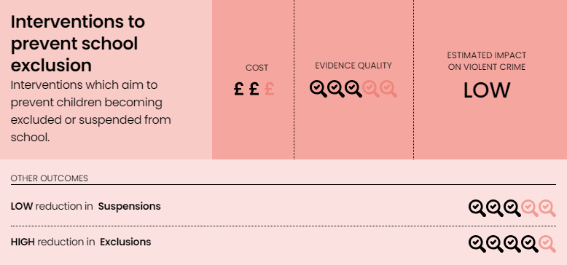
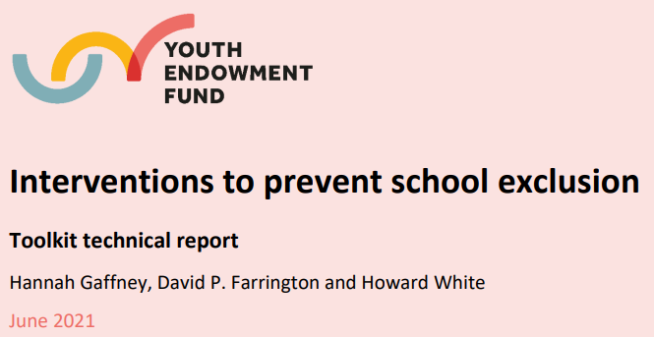
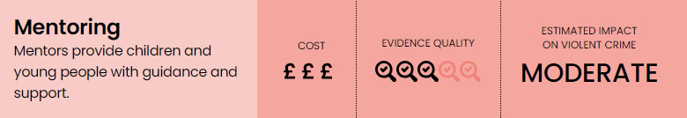
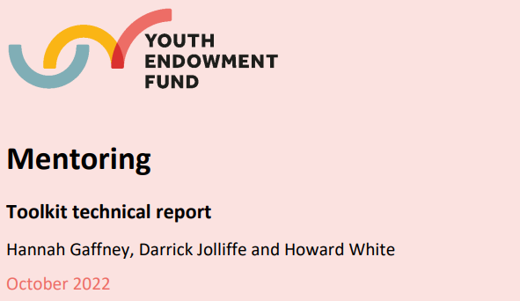
School Navigator Mentoring in Thames Valley
Combination of research areas for YEF:
  Mentoring identified as having potential for moderate impact on violence
  Interventions to prevent school exclusion identified as having low impact on violence and suspensions, but high impact on exclusion by YEF
How did we conduct the trial?
What did we find?
How have we adapted our delivery?

Slide 3
Suspension from School
Initial data analysis showed that around 70% of children who were suspended for the first time would go on to be suspended again in the same school year
  Disruption to their education
  Disruption to education of others
  Direct harm within schools (not usually recorded as crime)
  Teacher and administrative workload impacted significantly
An existing programme had been tested for process of implementation, but not for impact
So the idea was put through the research project lifecycle to work out the best way to implement…

Slide 4
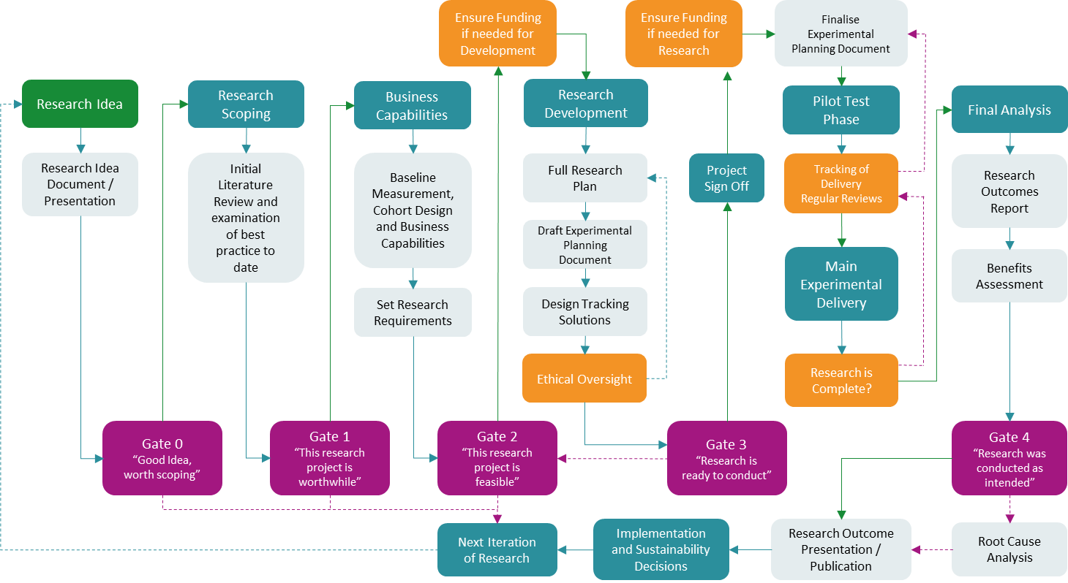
Research Project Lifecycle
Reference: Adapted from Olphin, T.P.A. (2023). Research Project Lifecycle: A Structured Approach to Conducting Research in the Public Sector. Reading, UK: Thames Valley Violence Reduction Unit. @ Crown Copyright 2023

Slide 5
Review of Previous Literature
Process evaluation showed it is possible to implement, but needs to be tested
Mentoring evidence is set across many different types of programme, so is not specific enough to base action in suspension prevention upon
Mentoring has been suggested to have an impact on:
  Changing prevalent outcomes in high risk groups
  School outcomes
  Social, psychological and health outcomes
  Self regulation
Very little strong evidence in school settings
Needs much more evidence to say what works and to what degree
Value for money is not known

Slide 6
What is the School Navigator Trial?
Cluster Randomised Controlled Trial
  Randomisation was done at the school level to ensure the most ethical way of testing this approach
  Four schools were randomised to receive treatment, four to control group
  Children at the schools in the treatment cohort became eligible following their first suspension from school in the school year
Does offering children, who have been suspended from school for the first time in a year, six sessions of mentoring; working with them to problem solve around their suspension from school, result in them being suspended from school less in the rest of the school year?​

Slide 7

Cohort Identification
Small budget available, so impact needed to be maximised by selecting cohort with likely resuspension
Good data science is essential for selecting productive cohorts
From a dataset from the previous year:
  about 70% of people were suspended again in the same year if suspended
  high resuspension rate makes this a high impact potential cohort

Slide 8
We worked with SOFEA…
SOFEA (South Oxfordshire Food and Education Alliance) is a social enterprise that tackles food poverty, empowers individuals, and strengthens communities. As a FareShare partner, SOFEA redistributes surplus food to reduce waste and provide essential resources to those in need
SOFEA creates lasting change by addressing immediate needs and empowering individuals for long-term success
What SOFEA Does:
Food Redistribution: Reduces food insecurity and waste by supplying surplus food to local organisations
Education & Training: Offers tailored programs to equip young people with skills and confidence, especially those disengaged from traditional education
Well-Being Support: Provides therapeutic activities, mentoring, and community trips to enhance mental and emotional health
School Navigator Program: Helps at-risk students remain in education through mentoring and personalised support
Community Impact:
Supplies nutritious food to thousands while cutting food waste
Empower young people to build skills, confidence, and brighter futures
Promotes mental well-being through tailored support
Strengthens community ties and resilience
Transforms lives through education, training, and mentoring

Slide 9
What was delivered?
Eligible schools identified
SOFEA delivered the program in schools
4 schools receiving treatment, 4 in control
165 referrals made following first suspension of year
6 sessions of mentoring, with a follow up session in following term
Those who completed the course of mentoring, were asked to complete the two self-assessed questionnaires (SDQ and WEMWBS)
Strengths and needs approach to exploring how to support a young person to make their own behaviour changes
  Trusted adult, who they could build a supportive relationship with
  Problem solving that is centred around the young person’s needs
  Done with the young person, not to them
Tracking at all stages
Randomised
Child Suspended for 1st Time in Year
Child Suspended for 1st Time in Year
Offered Mentoring
Business as Usual
Pre-trial Questionnaires
6 sessions of mentoring
Follow-up check in session
Post-trial Questionnaires

Slide 10
How is it delivered?
Funded by Thames Valley Violence Prevention Partnership as part of Home Office Violence Reduction Unit Programme
  Very small scale randomised trial
  £200,000 per year
  Design of intervention, research design, and evaluation conducted in house
SOFEA Milton Keynes
  Mentors, Administration, and Management of mentors
Data and Oversight support from Milton Keynes Council

Slide 11
Relationships and People
Identified a lack of knowledge around what works
Awareness of needing to have evidence to argue for funding to be spent in this way in times of austerity
SOFEA and Milton Keynes Council head of Education were both keen to work towards having evidence of what works in relation to mentoring for prevention of school suspension
All partners were incredibly active in the design and implementation of the programme
  SOFEA managed the tracking of referrals, questionnaire completion and delivery, and reported on delivery on a monthly basis allowing us to track progress of the project
  DI Kelly Reed managed the delivery of the project from the VPP side
  Where problems were identified in consent for referrals, a video message was produced to talk to parents about the offer. This appeared to assist with referral uptake

Slide 12

Results of the trial after full school year
A glossy ‘What Works’ report has been circulated, but please request it to be sent to you if you have not received it already. To reference, please use:
Olphin, T. & Reed, K. (2024) What Works Series: School Navigators Project, Thames Valley Violence Prevention Partnership: Kidlington, UK

Slide 13
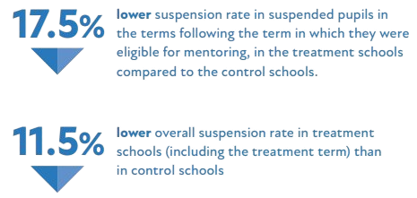
Overall Experimental Findings
There is less than 10% likelihood the finding was due to chance, and alongside questionnaire findings show strong evidence for this approach

Slide 14
Additional Information
The rate of suspension in the first month of the school year, before the mentoring commenced in October, was slightly higher in the treatment schools than the control schools, adding to the strength of findings
These results are likely to be lower than potentially possible, as only 165 out of 415 (39.8%) pupils who were suspended at the treatment schools received the intervention
  This may have been due to either the school not making a referral to the mentor for a reason, or the lack of parental consent to a referral.

Slide 15

Strengths and Difficulties Questionnaire (SDQ)
63 Strengths & Difficulties Questionnaires were completed
  38% response rate, so there is a risk of selection bias
The results from these showed:
  Significant reduction in total difficulties reported
  Significant reduction in total hyperactivity reported
  Significant reduction in total supplement score
  Near significant reduction in total externalising score
  However, there was also a significant reduction in their prosocial score as well.
  Non-significant reductions in internalising, emotional problems, conduct problems and peer problems measured

Slide 16
Warwick Edinburgh Mental Well Being Scale (WEMWBS)
87 WEMWBS were completed
  53% response rate, so there is a risk of selection bias
Significant increase in total score, a positive metric.
Furthermore, the WEMWBS can also indicate those children who would be in the lowest 15% of wellbeing, those who would be in the middle or standard wellbeing range, and then those in the highest 15% wellbeing range.
There was a doubling from four to eight of those pupils placed in the highest wellbeing range, and reduction of those in the lowest
Scales are simple to complete and score
Translated in over 25 different languages
Make the concept of mental wellbeing more accessible
Over 200 publications annually
Over 1200 registrations each year
Used in large population surveys across UK, Iceland and Spain
Adapted from The Warwick-Edinburgh Mental Wellbeing Scale (WEMWBS)

Slide 17
What has been achieved:
Navigator and Student perspectives
Emotional Regulation and Conflict Resolution
Boosting Confidence and Self-Worth
Breaking Negative Cycles
Students learned strategies to manage anger and frustration, avoid escalations, and improve interactions with peers and teachers. For example, calming techniques like counting exercises and understanding different perspectives were emphasised​ (Case Study J)​(Case Study Y)
Mentors helped students recognize their strengths and qualities, encouraging a more positive self-image and fostering resilience. Personalised goals like exploring interests (e.g., art, swimming lessons) allowed students to reclaim their individuality and focus on personal growth​(Case Study L)​(Case Study S)
Tangible strategies like allowing a fidget device or encouraging kickboxing discipline in school contexts led to immediate and lasting improvements in classroom behaviour and academic engagement​ (Case study O)​(Case study Y)
Creating Safe Spaces
Interventions addressed negative mindsets and recurring behaviour patterns, such as reacting to perceived unfairness or bullying. Students were equipped with tools to rebuild trust and foster healthier relationships with school staff and peers​ (Case study - O(2))​(Case study O)
The program provided students with a non-judgmental environment to discuss their struggles, empowering them to open up about challenges like family pressures, bullying, or cultural adjustments​ (Case Study M)​(Case Study T)
Practical Behavioural Adjustments

Slide 18
Quotes from Young People
“I have learnt to like myself and be at peace. I focus on the good stuff, not the bad stuff.” – A​ (Case study A)
“The sessions gave me a new perspective into life and how my actions will make a major impact. She taught me how to control my feelings and sit down to see how I can improve myself.” – M ​(Case study M)
“Having someone to talk to about being sent out of class and teachers has really helped. It also helped me a lot with sorting out attending lessons, that made a real difference.” – O ​(Case study O)
“I found it helpful being able to come in and talk.” – R​ (Case study R)
“I feel like the Queen of the World.” – S, reflecting on newfound positivity and self-confidence​ (Case Study S)

Slide 19
Statistical significance and confidence
Statistical significance is usually used to indicate that mathematically there is less than 5% likelihood that the finding was by chance
  However, it is not the only important thing:
    All of the findings going in the same direction also provide confidence in the combined findings
    There are no identified backfire effects and so, if seen as cost-effective, statistical significance may not be the most important thing
    Questionnaire findings and qualitative methods show strong reasons for why improvements may have been found
    Overall, 10% likelihood of findings having occurred by chance is a strong finding when combined with the other sources of evidence in a mixed methods approach, especially for a cost effective intervention

Slide 20

What do the findings go on to mean?
If we extrapolate from these findings, a reduction in the mean number of suspensions equates to 401.8 suspensions prevented per year, and at an average of 1.98 days per suspension, this would mean 795 days of education not missed
If each suspension requires just one hour of meetings and paperwork (an underestimate), this would result in a reduction in workload on a school of at least 400 hours – or almost an entire term

Slide 21
What does this mean?
Students at schools where six sessions of mentoring were provided following first suspension of the year, have lower re-suspension rates than students at schools without the school navigator programme
They also recorded improved scores in their self-reported emotional wellbeing and their ability to cope with a range of difficulties being experienced

Slide 22
Improved Suspension Rate
Improved Wellbeing
Improved Ability to Cope

Slide 23
Important Factors
Buy-in from school management and school staff is essential to run this kind of intervention. If the children are not encouraged to attend sessions that they have consented to undertake it can result in missed sessions
  This was also apparent in the quantity of eligible children who were not referred into the programme
  However, most children do seem to engage with this mentoring if offered, and if their parents give consent.
Experimental implementation was expensive in terms of delivery cost per child. While this could potentially have been somewhat reduced had we had more time and knowledge before the commencement of the trial
  However, randomisation can increase cost of delivery
  We could not choose schools that were close together
  More difficult for our mentors to travel into the locations to give mentoring
  Fewer schools also limited efficiency, and the number of sessions that could be delivered

Slide 24

Potential additional benefits
The reduction in future suspension rate, reductions in self-reported difficulties and improvements in emotional wellbeing may have knock on impacts on:
  Academic attainment
  Behaviour in the classroom; behaviour that is now not getting the child suspended
  May also have a knock on benefit on the behaviour and attainment of other children in the same classes
  Workload of teachers and school staff who deal with discipline, suspension, and meetings with parents of children who have been suspended
  Reductions in disciplinary work and paperwork relating to disciplinary action may well also have a knock on effect on teacher and school-staff member wellbeing and job satisfaction
Created with Microsoft Copilot

Slide 25
Implications for wider adoption and next steps
Potential for massive population level benefits; it is possible to reduce repeat suspension from schools, and therefore potentially reduce the impact of suspension from school on young people’s lives
Small trial, so would benefit from further testing and ideally a larger scale trial
Ideal implementation would involve either replication of test, or experimental implementation to test similar delivery
Results should be generalizable if delivering a very similar intervention, in a very similar cohort who have a similar rate of re-suspension
Good data science for cohort identification is essential for effective resource allocation, and this should be tested in other areas to test validity of this cohort selection criteria

Slide 26
Observations on Dosage and Exiting
Findings from this trial indicate that the level of dosage (six sessions of in-depth problem solving) is of benefit
Compared to other trials with higher dosage, such as our focused deterrence trial, these findings appear less impactful but also less resource intensive
The level of dosage that would be most effective has not been tested
It would be possible, and useful, to run a trial where the same treatment is given, but for different dosages to examine the impact change

Slide 27
Moving from Experiment to Implementation
Experiments can cause inefficiency, so need to examine processes for options that are more efficient
We performed value stream mapping and redesign of the delivery model with SOFEA, and have managed to identify a method for delivery of the programme to more schools, and more children
  Cost per child has been reduced from £1200 to £240
  Rolled out to 10 schools, including the control schools
  In the year of trial, we reached 165 children
  During October and November this year, there have already been 138 children referred for mentoring

Slide 28
Conclusions
Results of this trial are promising
  Improved suspension rate, Improved wellbeing, and Improved ability to cope
  It is possible to reduce repeat suspension from schools, and therefore potentially reduce the impact of suspension from school on young people’s lives
  Small Trial
    would benefit from replication and further testing on a larger scale
It has been possible to make the delivery of this project much more efficient to deliver following the experimental period
  This is something that should be considered in all implementations of research
  Experimenting to discover what works can introduce inefficiencies which should be reduced as far as possible before implementation to maximise value for money

Slide 29
How did it feel to deliver this as part of an RCT?
The process
Things we were nervous about
How we feel about it now
Benefits of gaining evidence
Making delivery more effective and efficient
Seeing the results

Slide 30
Questions

