Slide 1
Youth Justice Services and serious violence - a webinar for all Thames Valley partners
Milton Keynes Bracknell Reading
Oxfordshire Windsor & Maidenhead Youth Justice Board
Buckinghamshire Slough
West Berks Wokingham

Slide 2
The Youth Justice Board Role Responsibilities Child First approach

Slide 3
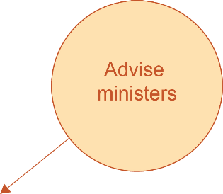
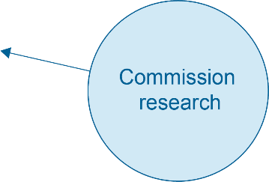
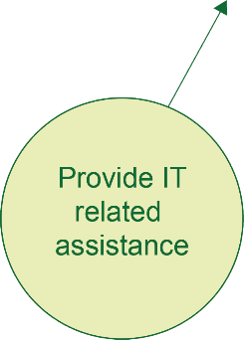
Statutory duties as set out in the Crime & Disorder Act1998

Slide 4
Central guiding principle:
Child First
Promote children’s individual
strengths and capacities to
Prioritise the best interests of
children and recognising their
particular needs, capacities,
rights and potential. All work is
child-focused, developmentally
informed, acknowledges
structural barriers and meets
responsibilities towards
children.
develop their pro-social identity
for sustainable desistance,
leading to safer communities
and fewer victims. All work is
constructive and future-
focused, built on supportive
relationships that empower
children to fulfil their potential
and make positive
contributions to society
Encourage children’s active
participation, engagement and
wider social inclusion. All work
is a meaningful collaboration
with children and their carers.
Promote a childhood removed
from the justice system, using
pre-emptive prevention,
diversion and minimal
intervention. All work minimises
criminogenic stigma from
contact with the system.

Slide 5
Statutory Duty Crime & Disorder Act 1998
Section 39 (1) requires the co-operation of the named statutory partners to form a YJS. Section 38 (1, 2)
Places a duty on them to co-operate to deliver youth justice services appropriate to their area.
the local authority
the police
the probation service
health (CCG now conferred to ICB)
co-ordinate the provision of youth justice services for all those in the local authority area who need them
carry out such functions assigned in the youth justice plan which has been formulated by the local authority after consultation with relevant bodies

Slide 6
Where do YJS sit within local, regional and national structures
Notes:
Domain one - Inspectors look at how the service is run and led, strategically. They look at workloads and staffing levels and whether there are arrangements for learning and development. Inspectors will look at any partnerships and services there may be and whether the right information is available, and facilities are in place to support staff. Partners at all levels are involved in the fieldwork aspect of the inspections themselves.

Slide 7
Community Safety Partnership
Ministry of Justice
Youth Justice Board
Youth Justice Service Partnership & Management Board (Strategic Overview)
TV Wide Meetings
PCC/VRU
Local Criminal Justice Board
Out of Court Disposal Scrutiny Panel
Victims / Witnesses / Restorative Justice
MAPPA
Digital Working
Reducing Reoffending
Criminal Justice Liaison & Diversion
Disproportionality
Health & Wellbeing Board
Youth Justice Service
Children’s Safeguarding Board
Childrens Social Care
Serious Violence strategy
Exploitation & Missing
Channel / Prevent
Youth Panel - Court

Slide 8
Standards and Key Performance Indicators (KPI)
Notes:
Domain one - Inspectors look at how the service is run and led, strategically. They look at workloads and staffing levels and whether there are arrangements for learning and development. Inspectors will look at any partnerships and services there may be and whether the right information is available, and facilities are in place to support staff. Partners at all levels are involved in the fieldwork aspect of the inspections themselves.

Slide 9
YJS are inspected by HMIP and accountable to YJS Partnership and Management Boards
HMIP STANDARDS
The following domains inspected:
Organisational Delivery
Court Disposals
Out of Court Disposals
Resettlement work
National Indicators (3) + KPIs (10)
KPI 9 – Serious Youth Violence:
“9.1.1 For the purposes of this KPI, Serious Violence is recorded in line with the YJB definition as any drug, robbery or violence against the person offence that has a gravity score of five or more resulting in a caution or court sentence.”
“9.1.2 The KPI will measure the number of proven Serious Violence offences and the proportion of proven Serious Violence offences as a proportion of total offences in the quarter and will look at the demographic breakdowns of children cautioned or convicted for these offences.”

Slide 10
LEARNING FOR THE FUTURE

Slide 11
Serious Violence Duty and Child First agenda
Co-production vs consultation (Serious Violence Strategy, Strategic Needs Assessments and CSP crime reduction strategy )
YJS are experts and therefore are central in the u18 crime and serious violence agenda: meaningful involvement
Strengthen the connection between VRU Coordinators and their YJS
Clear distinction between the CSP/YJS crime prevention agenda and the serious violence one
Reduce risk of duplicating resources and strategies

